Slide 1

School of Computer Engineering
Presentation for SY Project Design (Review 2)
AY 2024-25
Predictive Modelling in Education
Students Name:
Mandar Vijaykumar Ghadage (19)
Atharav Barapatre (075)
Darshan Bhabad (144)
Nikhil Bodre (07)
Guide:
Mr. Chaitanya Patil

Slide 2
Index
Introduction
Problem Statement
Objectives and Scope
Literature Survey(important)
Applications
Algorithm/Design/Implementation
Software/Hardware Requirement
References

Slide 3
Introduction
Developed an model to predict the next cutoff for MHT-CET based on analysis of previous 5 years' cutoff data.
The system takes input from users (e.g., expected score, preferred branch) and generates a list of colleges with predicted cutoffs.
Key Features: Automated prediction, personalized college suggestions, data-driven insights

Slide 4
Problem statement
CET Buddy
The unpredictability of MHT-CET cutoffs makes it difficult for students to plan their college choices effectively.
Traditional methods rely on historical data without predictive analysis, leading to uncertainty and potential misjudgments.
Proposed Solution: Design an model which by using python machine learning libraries viz.., pandas and numpy to predict future cutoffs by analyzing trends from previous years and considering individual user inputs.

Slide 5
Objectives and Scope
Objectives:
Accurate Prediction: Develop an python machine learning based model that predicts the MHT-CET cutoffs with high accuracy using data from the previous five years. The aim is to reduce uncertainty for students by providing reliable cutoff predictions.
User-Centric Approach: Tailor predictions based on individual user inputs, such as expected scores, preferred branches, and location preferences, ensuring that recommendations are personalized and relevant.
Efficiency in Decision-Making: Enable students to make informed decisions about college applications by providing a list of potential colleges ranked according to predicted cutoffs, streamlining the college selection process.

Slide 6
Objectives and Scope
Scope:
MHT-CET Focus: The project specifically targets MHT-CET, focusing on predicting cutoffs for engineering colleges within Maharashtra. The initial scope is limited to this exam, allowing for in-depth analysis and fine-tuning of the prediction model.
Future Expansion: The methodology developed can be adapted for other entrance exams and streams (e.g., medical, architecture) in the future, expanding the utility of the model beyond engineering.
Integration with Counseling Platforms: Potential integration with online counseling platforms to automatically suggest colleges to students during the admission process, making the tool more accessible and practical for end-users.
Customization and Scalability: The Python based machine learning model is designed to be scalable and customizable, allowing for the inclusion of additional features like seat availability, reservation quotas, and trends in student preferences.

Slide 7
Literature Survey
Machine Learning: Algorithms, Real-World Applications and Research Directions
2. Research Paper on Artificial Intelligence and Its Applications
3. What Drives Progress in AI? Trends in Algorithms
4. Exploring AI Models and Applications Within a System Framework
5. Feature Papers on Artificial Intelligence Algorithms and Their Applications
They are discussed further in details

Slide 8
1. Machine Learning: Algorithms, Real-World Applications and Research Directions
This paper offers a comprehensive overview of machine learning algorithms such as supervised learning, unsupervised learning, and reinforcement learning. It discusses their real-world applications in fields like healthcare, finance, and education, providing a broad understanding of how machine learning algorithms are applied in various domains. This paper also explores the future research directions in machine learning.
Key Takeaway for Your Project: Understanding the practical application of machine learning algorithms, like those for predicting college choices based on CET marks.

Slide 9
2. Research Paper on Artificial Intelligence and Its Applications
This paper outlines the evolution and scope of AI technologies, with specific attention to AI’s impact on various industries, including healthcare, education, and business. It includes an analysis of how AI algorithms can optimize decision-making processes and improve efficiency.
Key Takeaway for Your Project: AI can be applied in educational technology, like recommending colleges to students, to optimize decision-making based on individual inputs (e.g., CET scores, location).

Slide 10
3. What Drives Progress in AI? Trends in Algorithms
This paper, from MIT FutureTech, discusses how advancements in AI algorithms drive the overall progress in artificial intelligence. It focuses on the development of algorithms that enhance performance and their contribution to AI’s ability to solve complex problems, particularly in real-time systems.
Key Takeaway for Your Project: Understanding the trends in algorithm development helps you choose the right recommendation algorithm for college predictions.

Slide 11
4. Feature Papers on Artificial Intelligence Algorithms and Their Applications
This collection focuses on various AI algorithms such as evolutionary algorithms, genetic algorithms, and machine learning models. It also highlights how these algorithms are used in real-world applications, from healthcare diagnostics to autonomous vehicles.
Key Takeaway for Your Project: Evolutionary algorithms and machine learning techniques can help in optimizing recommendations and ranking colleges based on the student’s preferences and data.

Slide 12
5. Exploring AI Models and Applications Within a System Framework
This paper reviews the various AI models and strategies for intelligent search, classification, and optimization. It explores the role of AI in decision-making, pattern recognition, and data-driven analysis.
Key Takeaway for Your Project: For building a recommendation system, classification and optimization models can be crucial in ranking colleges and filtering results based on user preferences.

Slide 13
Applications of Project management tools
1.Task ManagementTools: Trello, AsanaUse: Organize tasks like data collection, model building, frontend design, and deployment. Assaign tasks and track progress easily.
2.Deployment and HostingTools: Heroku, AWSUse: Deploy the AI-based web app online, making it accessible for students to input CET marks and receive college recommendations.
3.Version ControlTools: Git, GitHubUse: Track changes in Python code, manage branches for different features, and collaborate seamlessly with team members.

Slide 14
Applications of Project management tools
4.Collaboration and CommunicationTools: Slack, Microsoft TeamsUse: Discuss tasks, share Python code, and resolve issues in real-time. Maintain clear communication among team members.
5.Bug and Issue TrackingTools: GitHub Issues, JiraUse: Log and fix bugs in Python scripts and web interface (e.g., errors in filters, data sorting, or incorrect outputs).
6.Documentation ManagementTools: Google Docs, NotionUse: Document project steps, Python libraries, and user guides. Ensure all information is easy to access and update.

Slide 15
Algorithm/Design/Implementation
Algorithm
Description: The core algorithm will generate a list of college recommendations based on user inputs such as CET marks, location, type of college, and placement statistics.
Steps of the Algorithm:
1)Input Collection: Collect inputs: CET marks (rank), category, preferred branches, location, and college type.
2)Data Filtering:Use user-defined filters to narrow down the list of colleges.Filters include location, college type (government/autonomous), and placement stats.
3)Rank Comparison:Compare the user's CET marks/rank with historical cutoff data from the last 5 years.Match the user's rank with the closest cutoff ranks in the dataset.

Slide 16
Algorithm/Design/Implementation
4)Sorting and Ranking:Sort the filtered colleges based on cutoffs, starting from the best match.Rank colleges based on the likelihood of admission (higher chances first).
5)Generate Recommendation List:Create a final list of recommended colleges based on the processed data.Include relevant details (college name, branch, location, cutoff rank).

Slide 17
Algorithm/Design/Implementation
Design:
Frontend (User Interface):
Technology: HTML, CSS, JavaScript (for interactivity).
Purpose: Collect user inputs (CET marks, filters) and display results.
Backend:
Technology: Python with Flask/Streamlit.
Purpose: Handle user inputs, process the AI algorithm, and return recommendations.
Database:
Technology: CSV file or SQL database.
Data: Historical cutoff data for colleges (5 years), including:
College name
Branch
Category
Cutoff rank
Location

Slide 18
Algorithm/Design/Implementation
3. Implementation
Technologies:
Programming Language: Python
Libraries:
Pandas: For data manipulation and filtering.
NumPy: For numerical operations.
Flask/Streamlit: To build and host the web application.

Slide 19
Hardware Requirements Development Machine: Processor: Intel Core i5 or higher RAM: 8 GB (minimum), 16 GB (recommended for faster processing) Storage: 256 GB SSD (minimum), 512 GB SSD (recommended) Operating System: Windows 10/11, macOS, or Linux (Ubuntu) Server Requirements (for Deployment): Processor: Intel Xeon or equivalent RAM: 8 GB (minimum), 16 GB (recommended) Storage: 100 GB (minimum) Operating System: Linux (Ubuntu), Windows Server, or cloud services like AWS, Heroku, or Azure Internet Connection: A stable connection for data collection, development, and deployment.
Hardware/Software Requirement

Slide 20
Hardware/Software Requirement
Software Requirements:
1)Python Libraries:
Pandas: For data manipulation and analysis
NumPy: For numerical computations.
scikit-learn: For implementing machine learning algorithms.
Flask: For backend web development.
Streamlit: For creating simple web interfaces.
2)Web Development Tools:
HTML, CSS, JavaScript: For frontend design and interactivity.
3)Database:
SQLite/MySQL: To store historical CET cutoff data and college details.
Install SQLite: Comes built-in with Python.
Install MySQL: MySQL Download

Slide 21
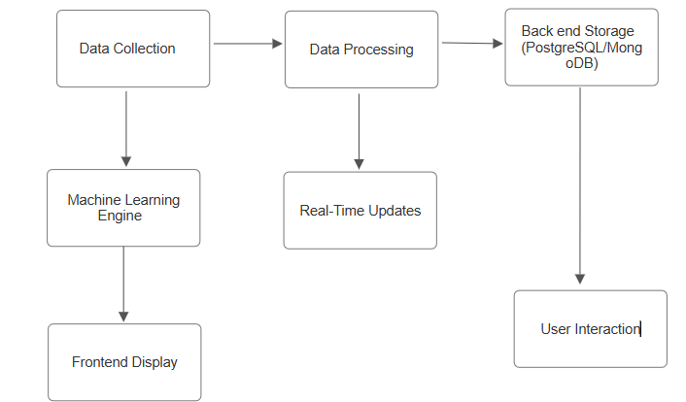
Block diagram

Slide 22
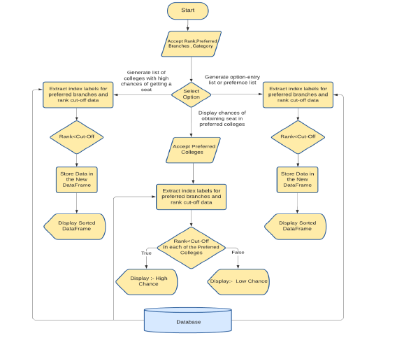
UML diagram

Slide 23
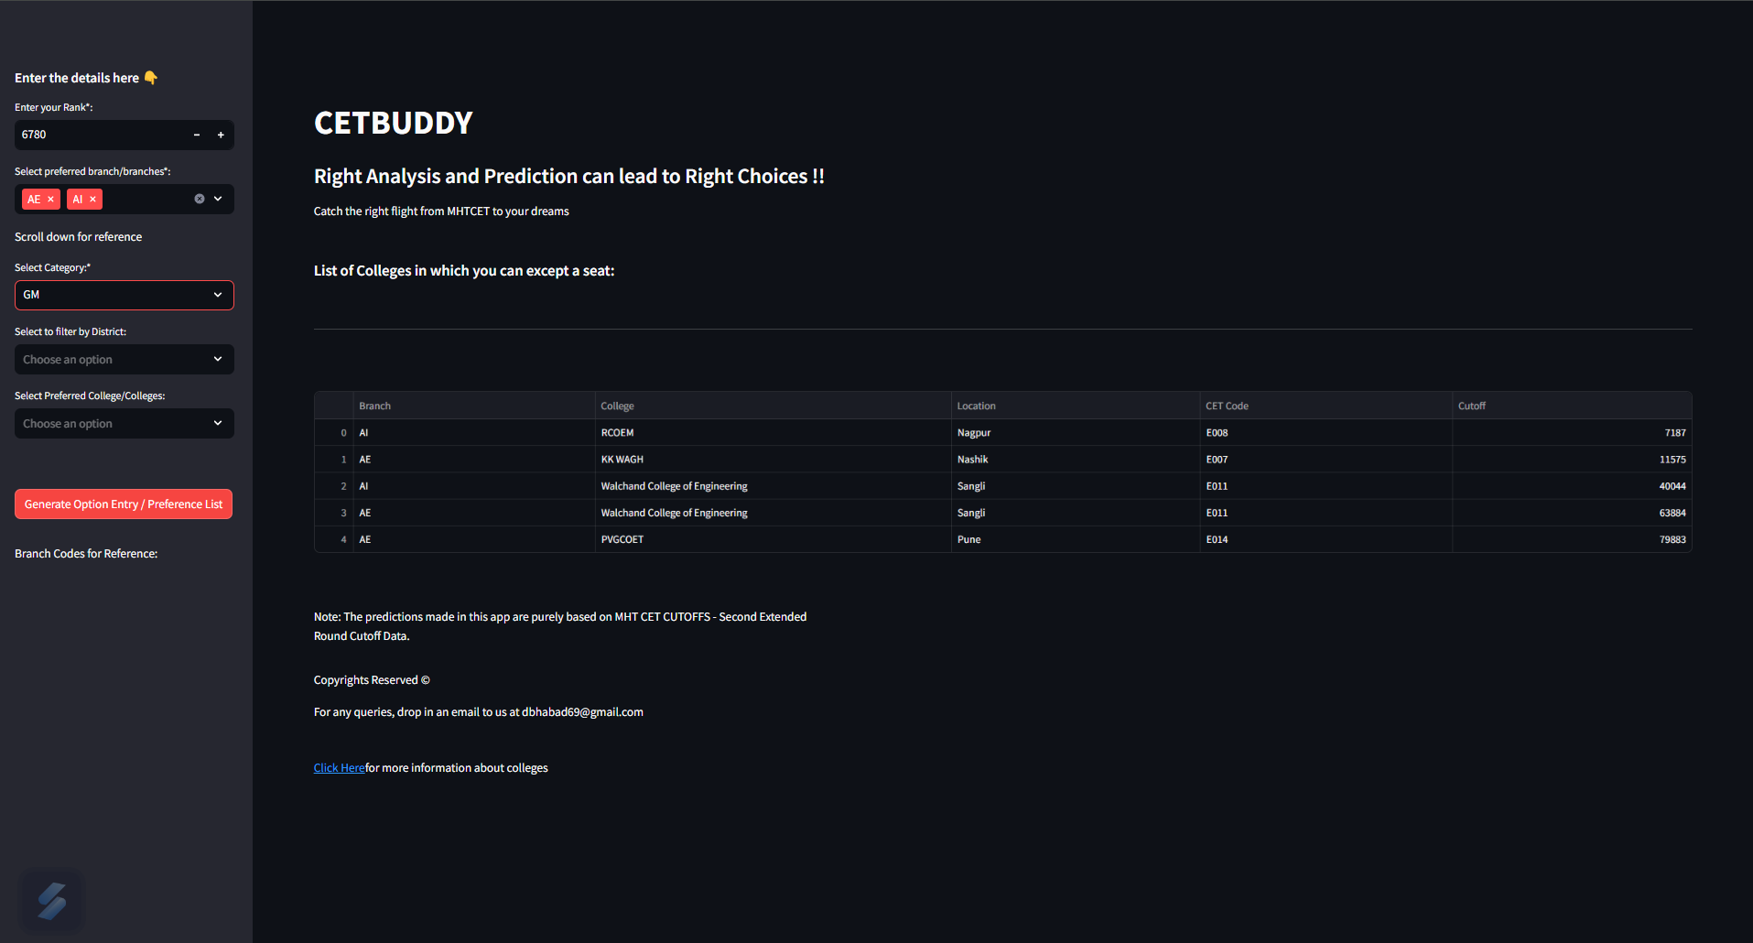
Screenshots Of Outcome/Output

Slide 24
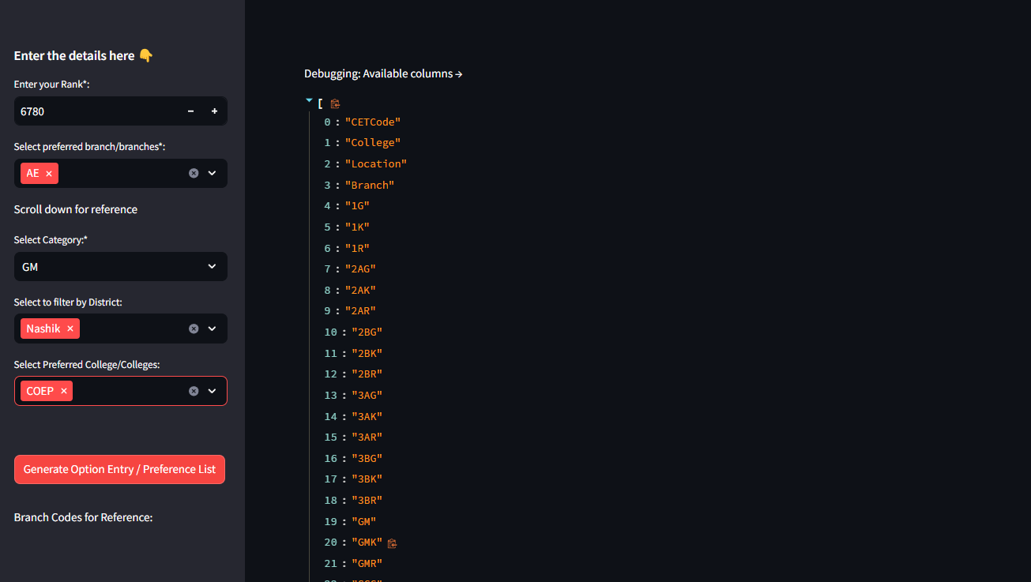
Screenshots Of Outcome/Output

Slide 25
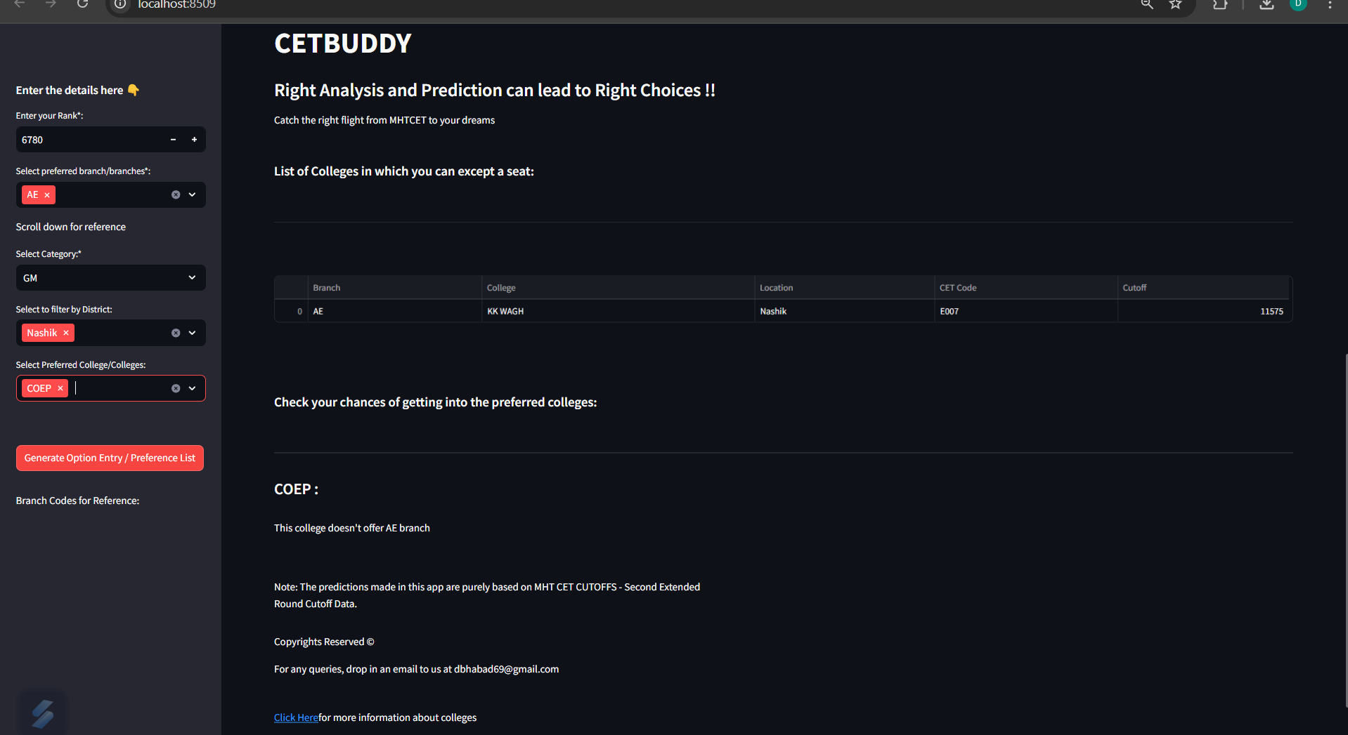
Screenshots Of Outcome/Output

Slide 26
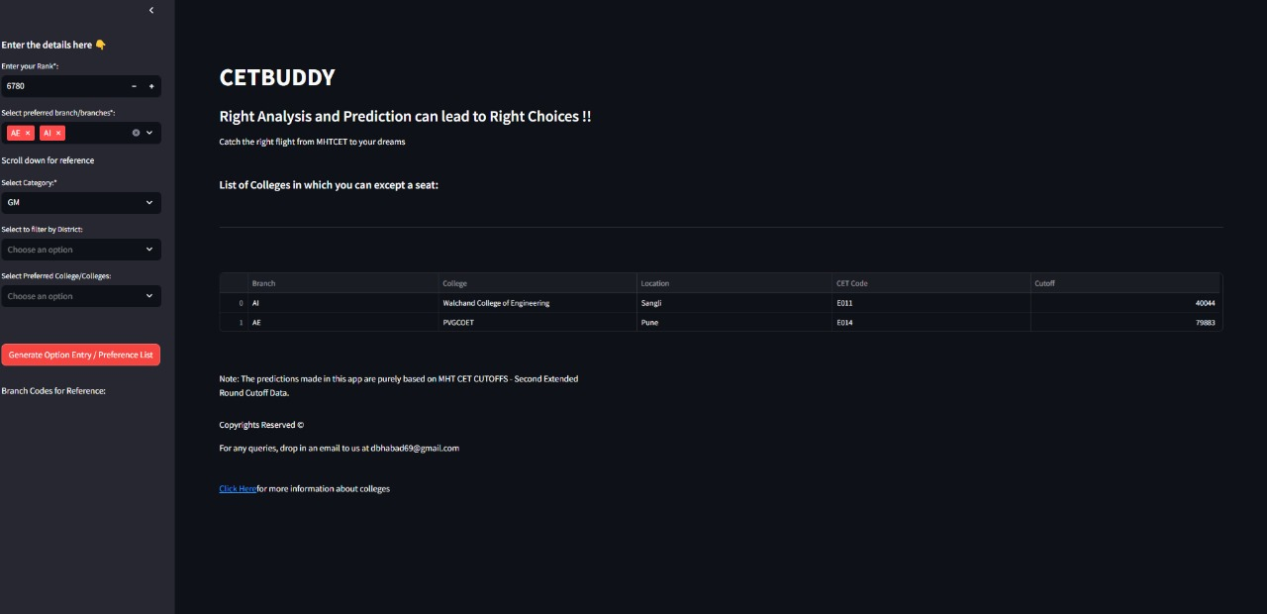
Screenshots Of Outcome/Output

Slide 27
Selected References
[1] IoannisHatzilygeroudis, AnthiKaratrantou, “An Expert System with Certainty Factors for PredictingStudent Success”, Edited Negoita M.G., Howlett R.J., Jain L.C. Springer-Verlag Berlin Heidelberg publisher, vol. 3213, pp. 292–298, (2004).
[2] James SMoore, “An expert system approach to graduate school admission decisions and academic performance prediction”, Omega International Journal of Management Science, vol. 26, issue 5, pp. 659–670, (1998).
[3] William Eberle et al. Using Machine Learning and predictive modeling to assess admission policies and standards, Proceedings of 9th annual symposium, The university of Oklahoma (2013).

Slide 28
Thank You!!
Any questions.

